Slide 1
Computer Organization & Assembly Language
The String Instructions

Slide 2
The Direction Flag
The control flags are used to control the processor operations
Direction Flag (DF)
Purpose is to determine in which string operations will determined
These operations are implemented by the two index registers SI and DI

Slide 3
Example
STRING1 DB ‘ABCDE’
String is stored in memory storing at offset 0200h
If DF = 0, SI and DI proceed in direction of increasing memory addressed, from left to right across the string.
If DF = 1, SI and DI proceed in direction of decreasing memory addressed
Offset Address | Content | ASCII Character
0200h | 041h | A
0201h | 042h | B
0202h | 043h | C
0203h | 044h | D
0204h | 045h | E

Slide 4
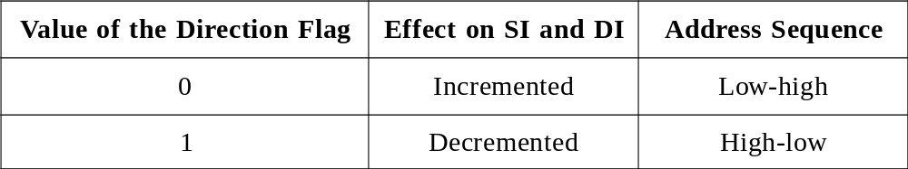
CLD and STD
To clear DF = 0 use CLD instruction
To set DF = 1, use STD instruction
CLD and STD have no effect on the other flags

Slide 5
Moving a String
  MOVSB
  Copies the contents of the byte addressed by DS:SI, to the byte addressed by ES:DI.
  The contents of the source byte are unchanged.
  Both SI and DI is incremented if DF =0 or decremented if DF = 1
  MOVSW
  Copies the contents of the word addressed by DS:SI, to the word addressed by ES:DI.
  The contents of the source word are unchanged.
  Both SI and DI is increased by 2 if DF =0 or decreased by 2 if DF = 1
  MOVSB and MOVSW have no effect on the flags

Slide 6
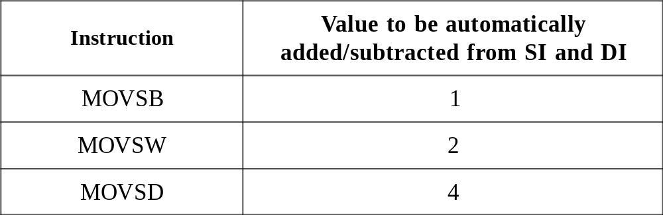
MOVS (Move String Data).

Slide 7
Example
.DATA
STRING1 DB ‘HELLO’
STRING2 DB 5 DUP (?)
.CODE
MOV AX , @DATA
MOV DS , AX
MOV ES , AX
LEA SI , STRING1 ; SI points to source string
LEA DI , STRING2 ; DI points to destination string
CLD ; Clear DF
MOVSB ; Move first byte
MOVSB ; Move second byte
RET

Slide 8
The REP prefix
.CODE
MOV AX , @DATA
MOV DS , AX
MOV ES , AX
LEA SI , STRING1
LEA DI , STRING2
CLD
MOV CX , 5
REP MOVSB
RET

Slide 9
Example
Copy the contents of a string to other string in reverse order
.CODE
MOV AX , @DATA
MOV DS , AX
MOV ES , AX
LEA SI , STRING1+4
LEA DI , STRING2
STD
MOV CX , 5
MOVE:
MOVSB
ADD DI , 2
LOOP MOVE
RET

Slide 10
Example (MOVSW)
.DATA
ARR DW 10,20,40,50,60,?
.CODE
STD
LEA SI,ARR+8H ;SI points to 60h
LEA DI,ARR+0AH ;DI points to ?
MOV CX,3 ; 3 elements to move
REP MOVSW ; move 40, 50, 60
MOV [DI],30H ; insert 30
RET

Slide 11
MOVS (Move String Data)
Equivalent Instruction of MOVSW
  MOV AX, DS: [SI]
  MOV ES: [DI], AX
Equivalent Instruction of MOVSB
  MOV AL, DS: [SI]
  MOV ES: [DI], AL

Slide 12
Store String
  STOSB
  Move the contents of AL register to the byte addressed by ES:DI, DI is incremented if DF =0 or decremented if DF = 1
  STOSW
  Move the contents of AX register to the word addressed by ES:DI, DI is increased by 2 if DF =0
  STOSB and STOSW have no effect on the flags
Equivalent Instruction of STOSW
  MOV ES: [DI], AX
Equivalent Instruction of STOSB
  MOV ES: [DI], AL

Slide 13
Example (STOSB)
.DATA
STRING1 DB 'HELLO'
.CODE
MOV AX,@DATA
MOV ES,AX
LEA DI,STRING1
CLD
MOV AL,'A‘ ;AL has character to store
STOSB ;store an ‘A’ in STRING1
STOSB ;store another ‘A’ in STRING1
RET

Slide 14
Reading And Storing A Character String
chars_read = 0
read a char
WHILE char is not a carriage return DO
IF char is backspace THEN
chars_read = chars_read – 1
remove previous char from string
ELSE
store char in string
chars_read = chars_read + 1
END_IF
read a char
END_WHILE

Slide 15
Reading And Storing A Character String
.DATA
STRING1 DB 50 DUP (?)
.CODE
MOV AX,@DATA
MOV ES,AX
CLD
XOR BX,BX
LEA DI,STRING1
MOV AH,1
INT 21H
WHILE1:
CMP AL,0DH
JE END_WHILE
CMP AL,8H
JNE ELSE1
DEC DI
DEC BX
JMP READ
ELSE1:
STOSB
INC BX
READ:
INT 21H
JMP WHILE1
END_WHILE:
RET

Slide 16
Load String
  LODSB
  Move the byte addressed by DS:SI into AL, SI is incremented if DF =0 or decremented if DF = 1
  LODSW
  Move the word addressed by DS:SI into AX, SI is increased by 2 if DF =0 or decreased by 2 if DF = 1
  LODSB and LODSW have no effect on the flags
Equivalent Instruction of LODSW
  MOV AX, DS: [SI]
Equivalent Instruction of LODSB
  MOV AL,DS: [SI]

Slide 17
Example
.DATA
STRING1 DB 'ABC'
.CODE
MOV AX,@DATA
MOV DS,AX
LEA SI,STRING1
CLD
LODSB ;load first byte into AL
LODSB ;load second byte into AL
RET

Slide 18
Scan String
  Use to examine a string for a target byte/word
  SCASB
  Target byte is contained in AL
  Subtract the string byte pointed to by ES:DI from the contents of AL and uses the result to set the flags
  DI is incremented if DF =0 or decremented if DF = 1
  SCASW
  Target word is contained in AX
  Subtract the string word addressed by ES:DI from AX and set the flags.
  DI is increased by 2 if DF =0 or decreased by 2 if DF = 1
  All status flags are affected by SCASB and SCASW

Slide 19
Example
.DATA
STRING1 DB 'ABC'
.CODE
MOV AX,@DATA
MOV ES,AX
LEA DI,STRING1
CLD
MOV AL,'B‘ ;target character
SCASB ;scan first byte
SCASB ;scan second byte
RET

Slide 20
Compare String
  CMPSB
  Subtracts the byte with address ES:DI, from the byte addressed by DS:SI.
  The result is not stored
  Both SI and DI is incremented if DF =0 or decremented if DF = 1
  CMPSW
  Subtracts the word with address ES:DI, from the word addressed by DS:SI
  Both SI and DI is increased by 2 if DF =0 or decreased by 2 if DF = 1
  All status flags are affected by CMPSB and CMPSW

Slide 21
Example
.DATA
STRING1 DB 'ACD'
STRING2 DB 'ABC'
.CODE
MOV AX,@DATA
MOV DS,AX
MOV ES,AX
CLD ;left to right processing
LEA SI,STRING1
LEA DI,STRING2
CMPSB ;compares first byte
CMPSB ;compares second byte
RET

Slide 22
Chapter # 11, Question # 1
Suppose
  SI contains 100h Byte 100h contains 10h
  DI contains 200h Byte 101h contains 15h
  AX contains 4142h Byte 200h contains 20h
  DF = 0 Byte 201h contains 25h
Give the source, destination, and the value moved for each of the following instructions. Also give the new contents of SI and DI.
MOVSB
MOVSW
STOSB
STOSW
LODSB
LODSW

Slide 23
Solution
No. | Instructions | Values (Contents in hex, of the source or destination which modified) | Values of SI or DI which modified
1. | MOVSB | [0200]=10h | SI=101h, DI=201h
2. | MOVSW | [0200]=1015h | SI=102h, DI=202h
3. | STOSB | [0200]= 42h | DI=201h
4. | STOSW | [0200]=4142h | DI=202h
5. | LODSB | AL=10h | SI=101h
6. | LODSW | AX=1510h | SI=102h

Slide 24
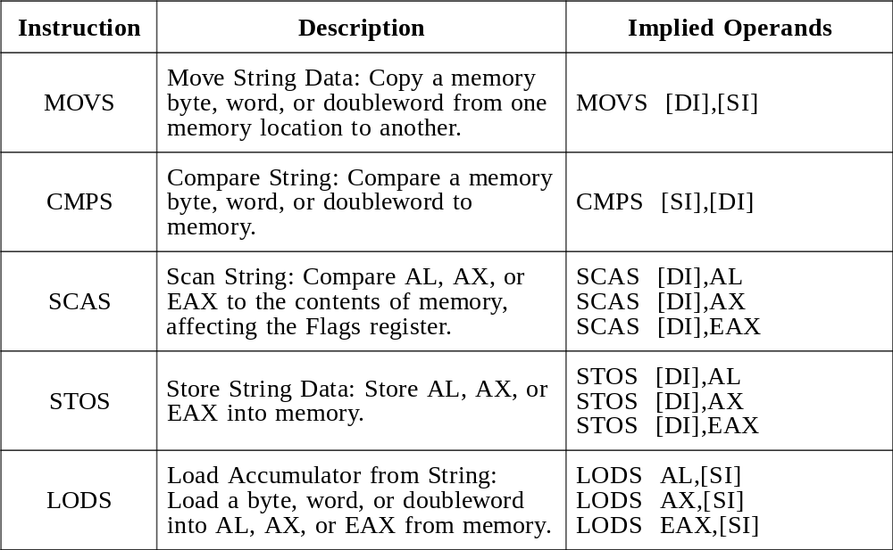
  Table 1. String Primitive Instructions, Implied Operands.

Slide 25
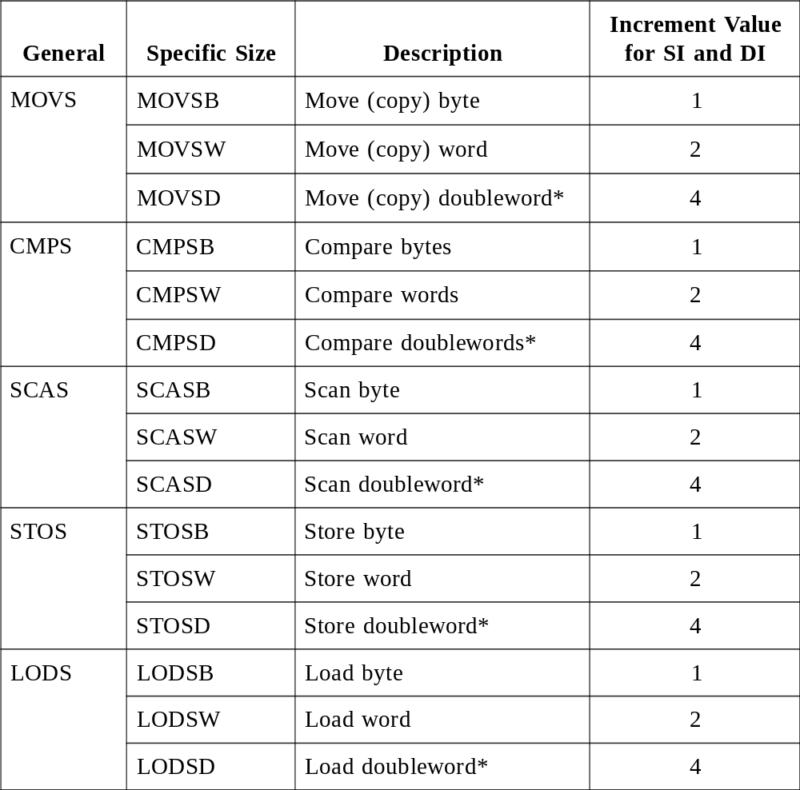
  Table 2. Overview of String Primitive Instructions.

